Slide 1
STATISTICS AND PROBABILITY

Slide 2
What is Statistics ?
Statistics is the science of Collecting, Organizing, Analyzing, Interpreting and Presenting data.
Types of Statistics:
Descriptive Statistics : Measures of Central Tendency, Measures of Dispersion, Frequency Distributions, Data Visualization.
Inferential Statistics : Hypothesis Testing, Confidence Intervals, Regression Analysis, Correlation, Probability Distributions.

Slide 3
Descriptive Statistics
To summarize and describe the main features of a dataset.
It helps you understand “what happened” in your data.
Methods:
Measures of Central Tendency
Measures of Dispersion
Frequency Distributions
Data Visualization

Slide 4
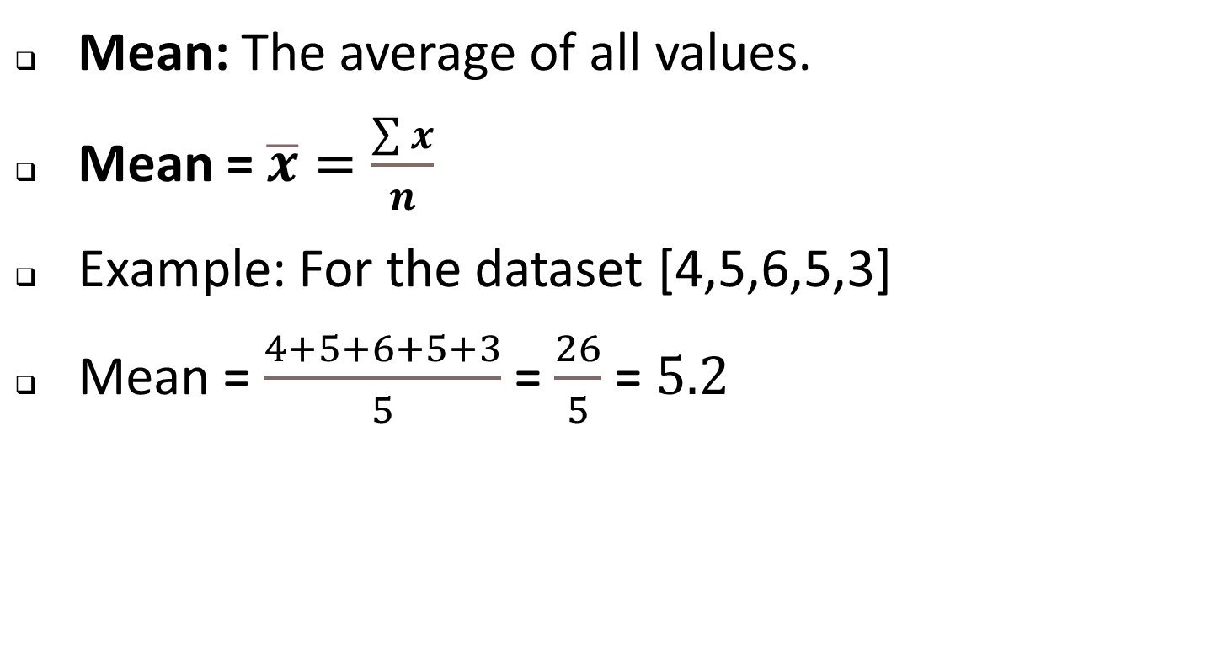
Measures of Central Tendency

Slide 5
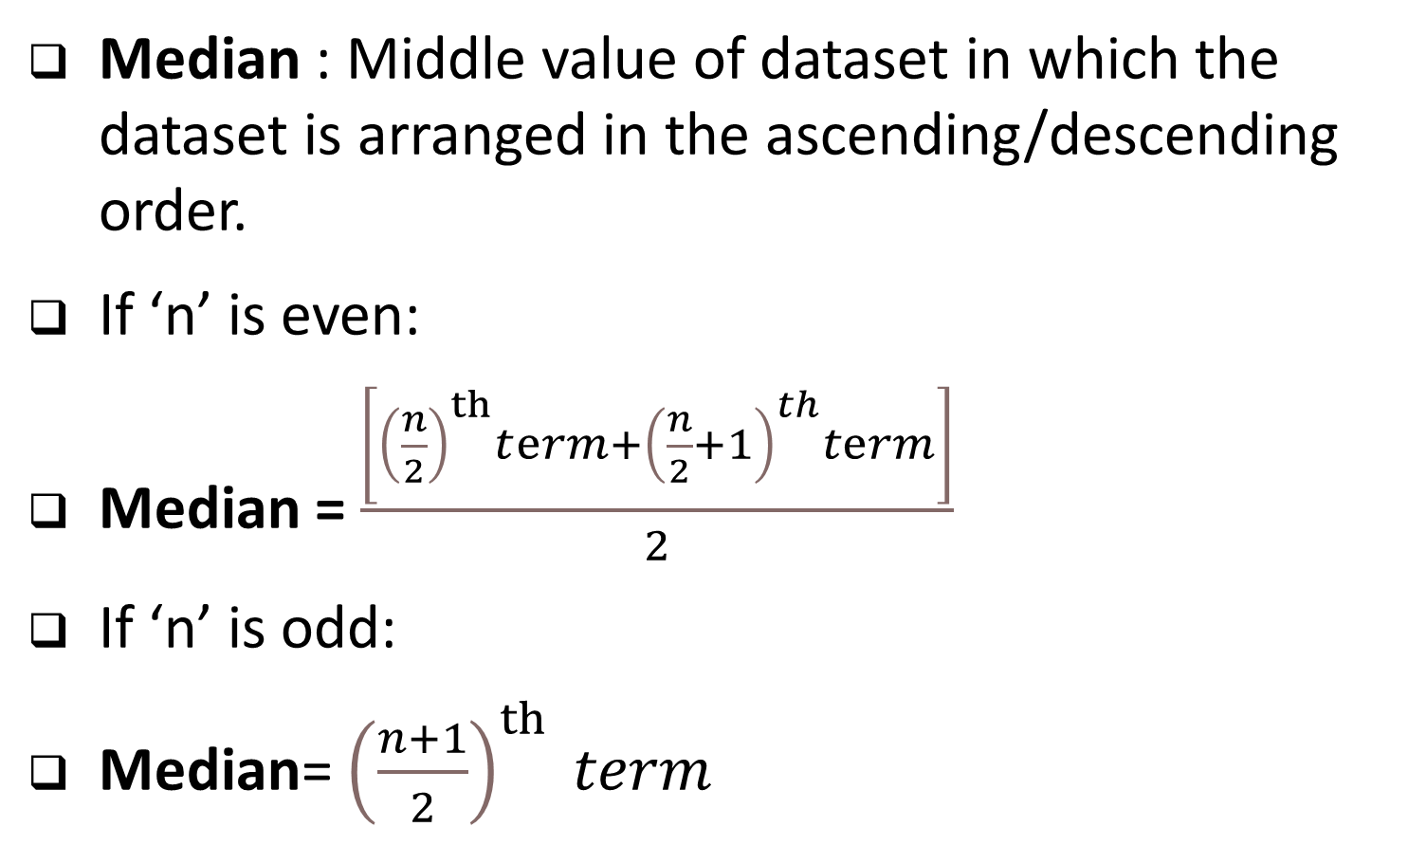

Slide 6
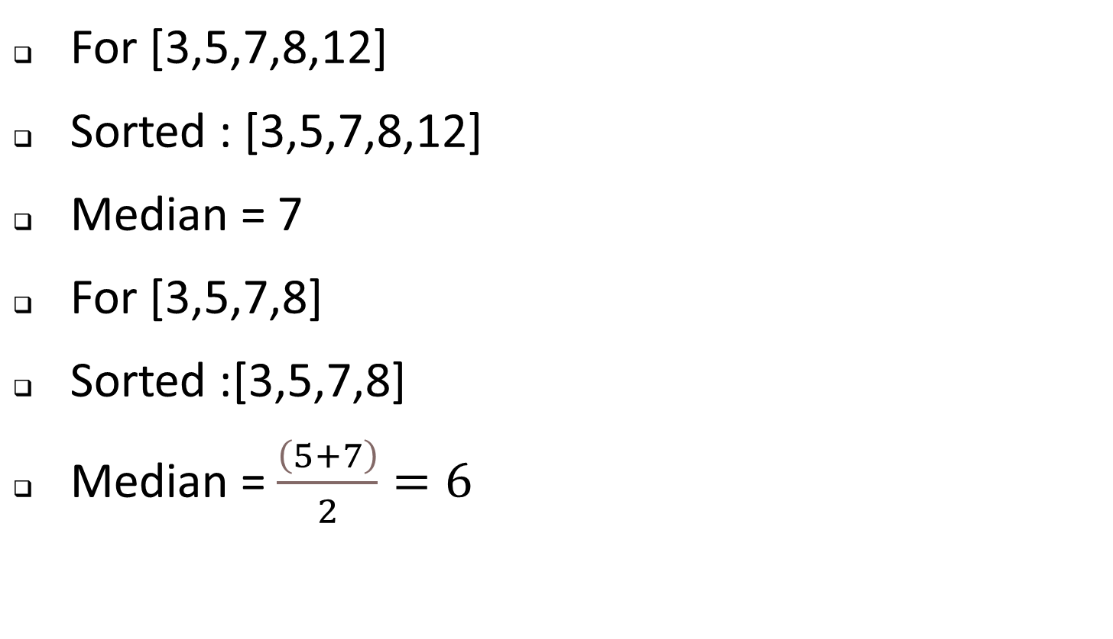
Example

Slide 7
MODE
The most frequently occurring value in the dataset.
Mode = Term with highest frequency.
Example : [1,2,2,3,4] mode is 2.

Slide 8
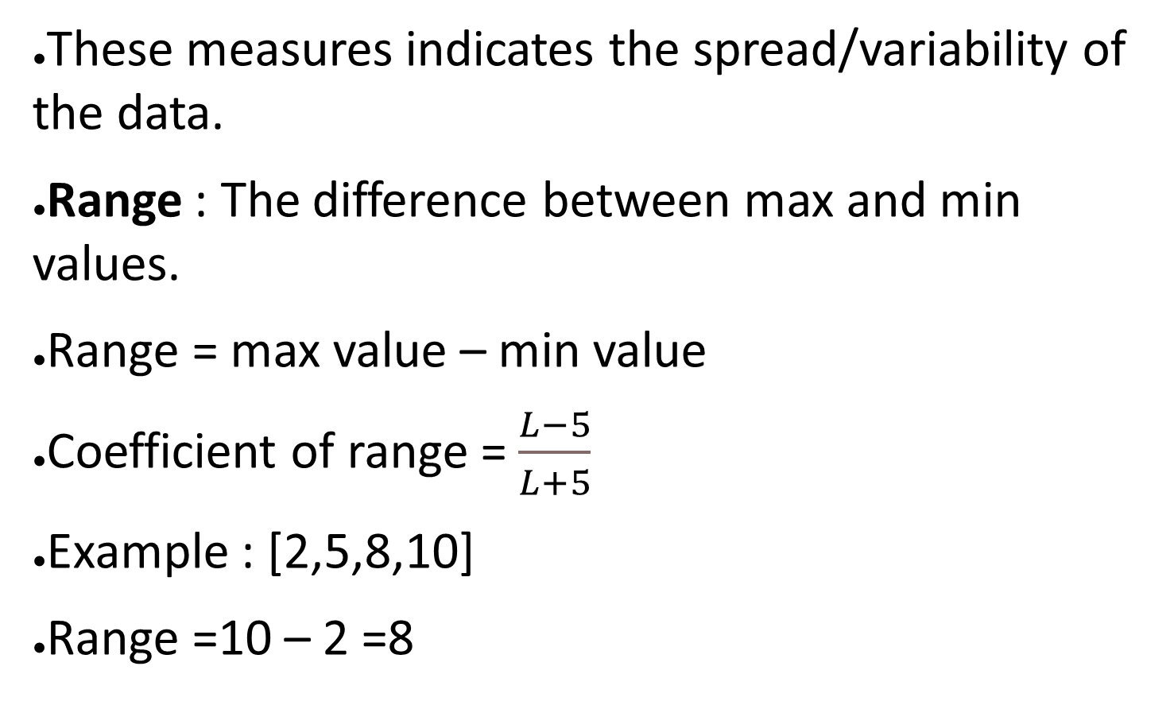
Measures of Dispersion/Spread/Variation

Slide 9
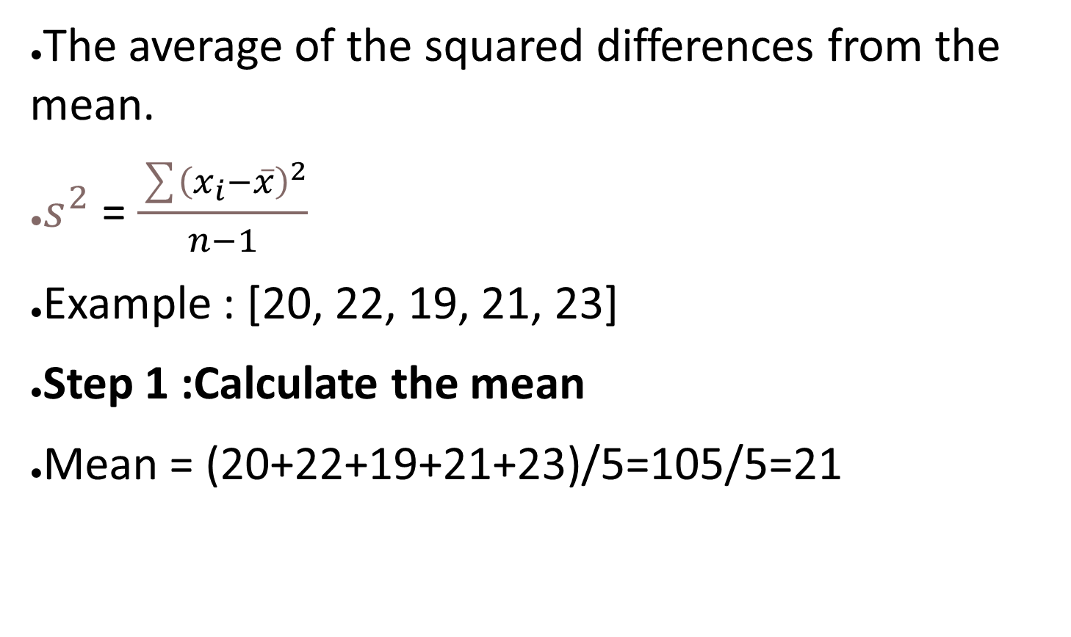
VARIANCE

Slide 10
Step 2: Calculate the deviations from the mean for each temperature.
20−21=−1
22−21=1
19−21=−2
21−21=0
23−21=2

Slide 11
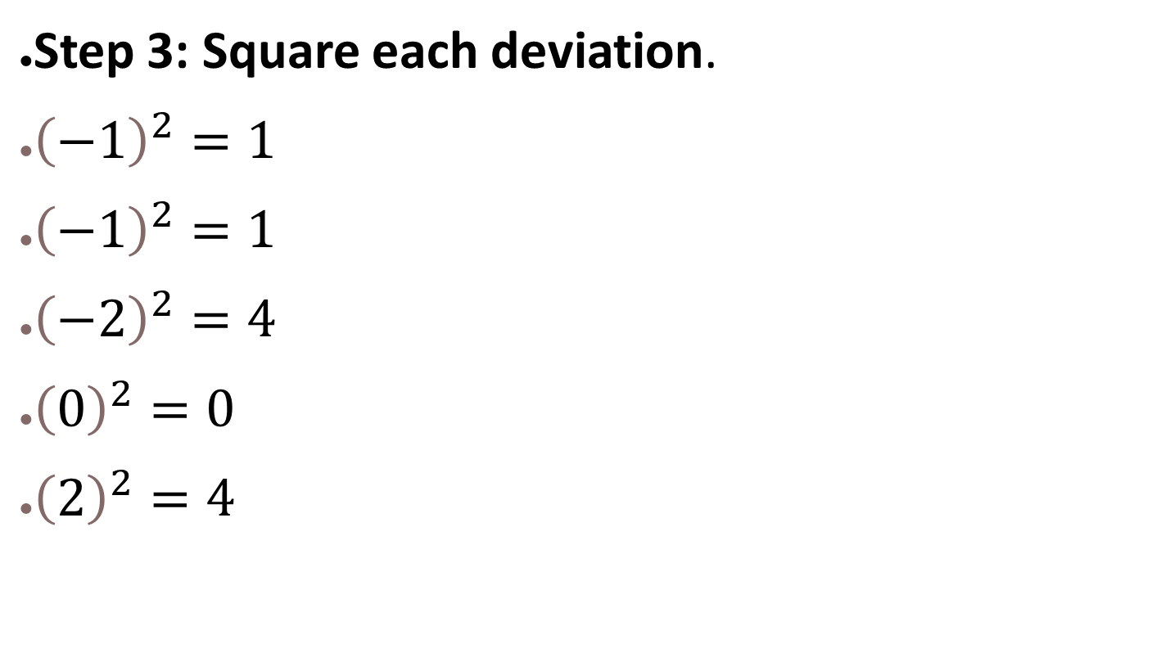

Slide 12
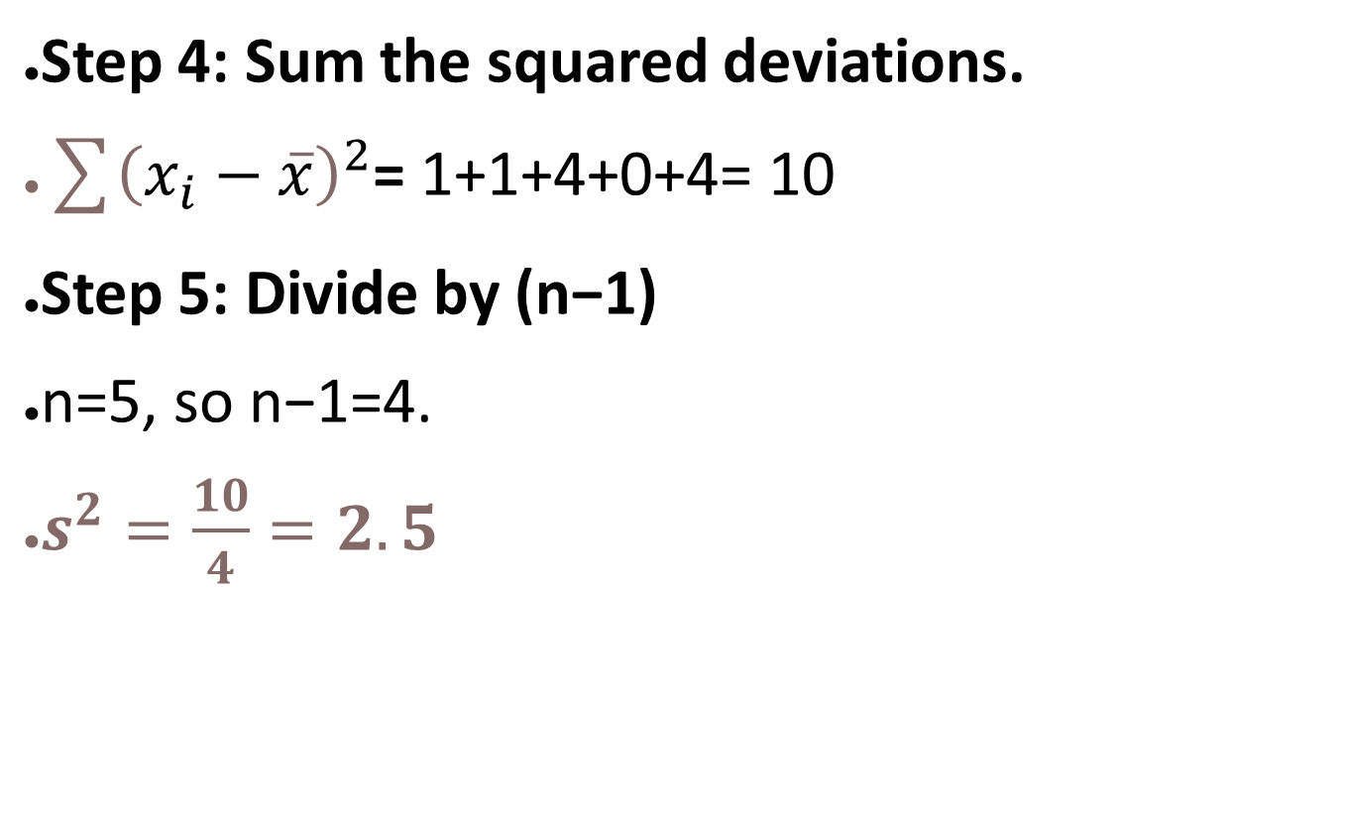

Slide 13
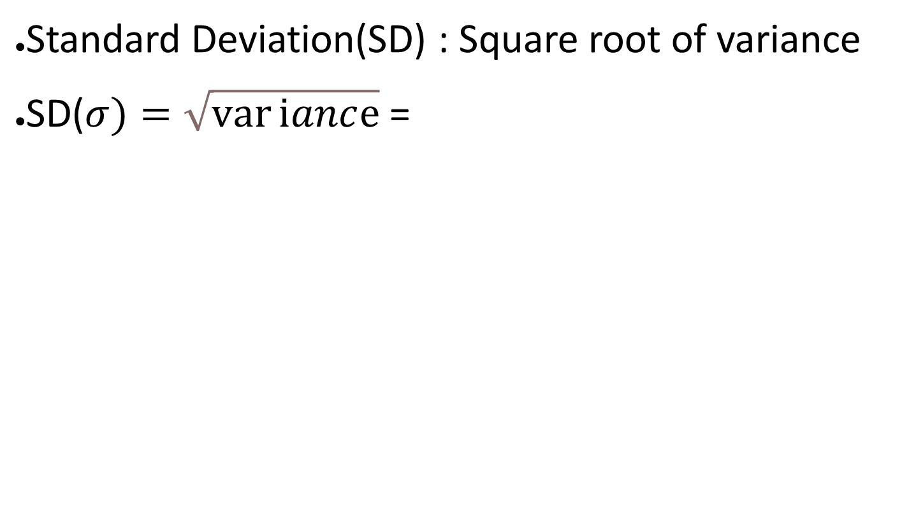

STANDARD DEVIATION

Slide 14
INTERQUARTILE RANGE(IQR)
The range between first quartile (Q1) and the third quartile (Q3)
IQR= Q3-Q1

Slide 15
Calculate the IQR for an odd no. of observations
Arrange the data : Sort the dataset in ascending order.
Find the median(Q2) : This will divide the data in 2 halves.
Find Q1(First Quartile) : This is the median of the lower half of the data (excluding median)
Find Q3(Third Quartile): Upper half of the data (excluding median)
Calculate IQR

Slide 16
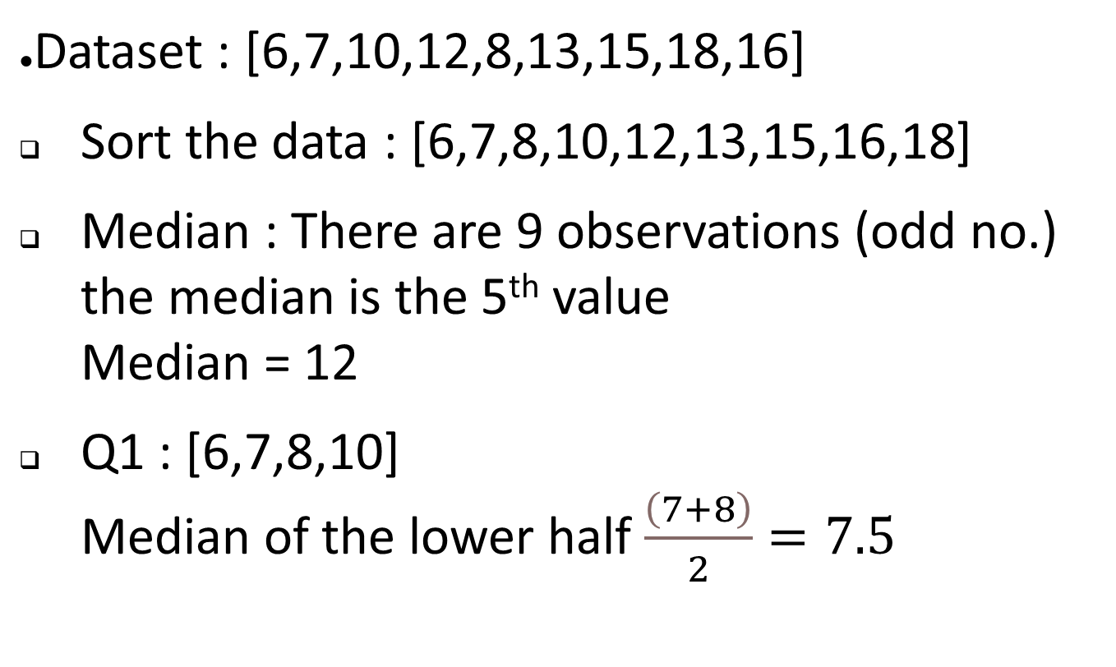
EXAMPLE

Slide 17
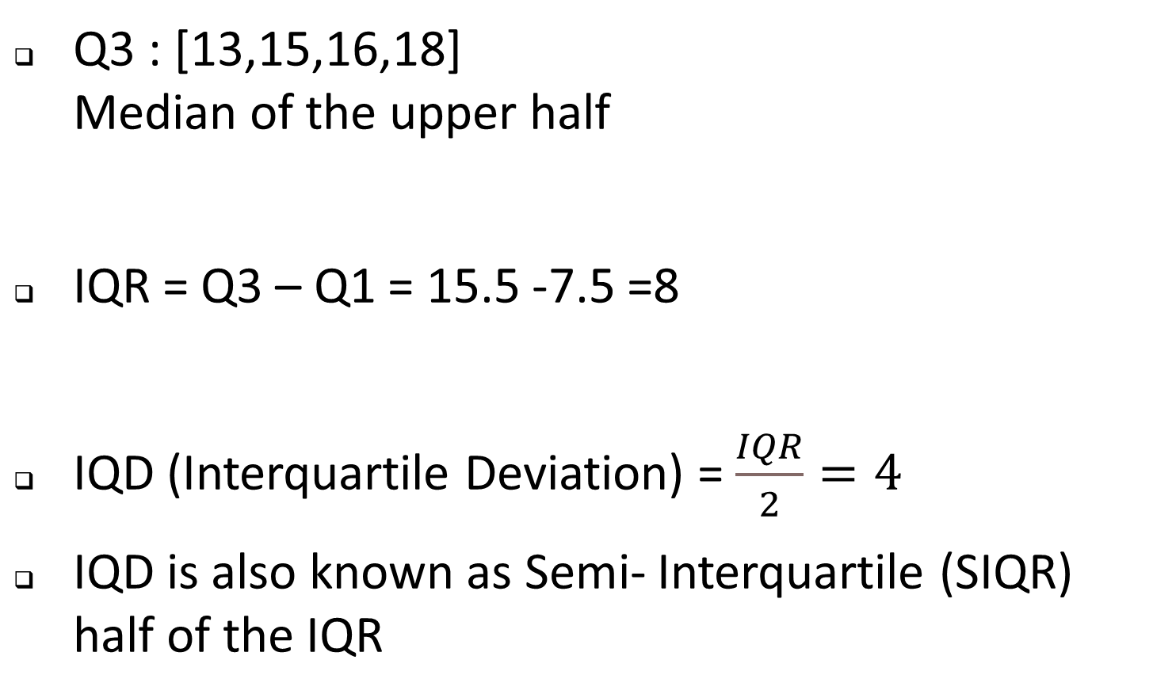


Slide 18
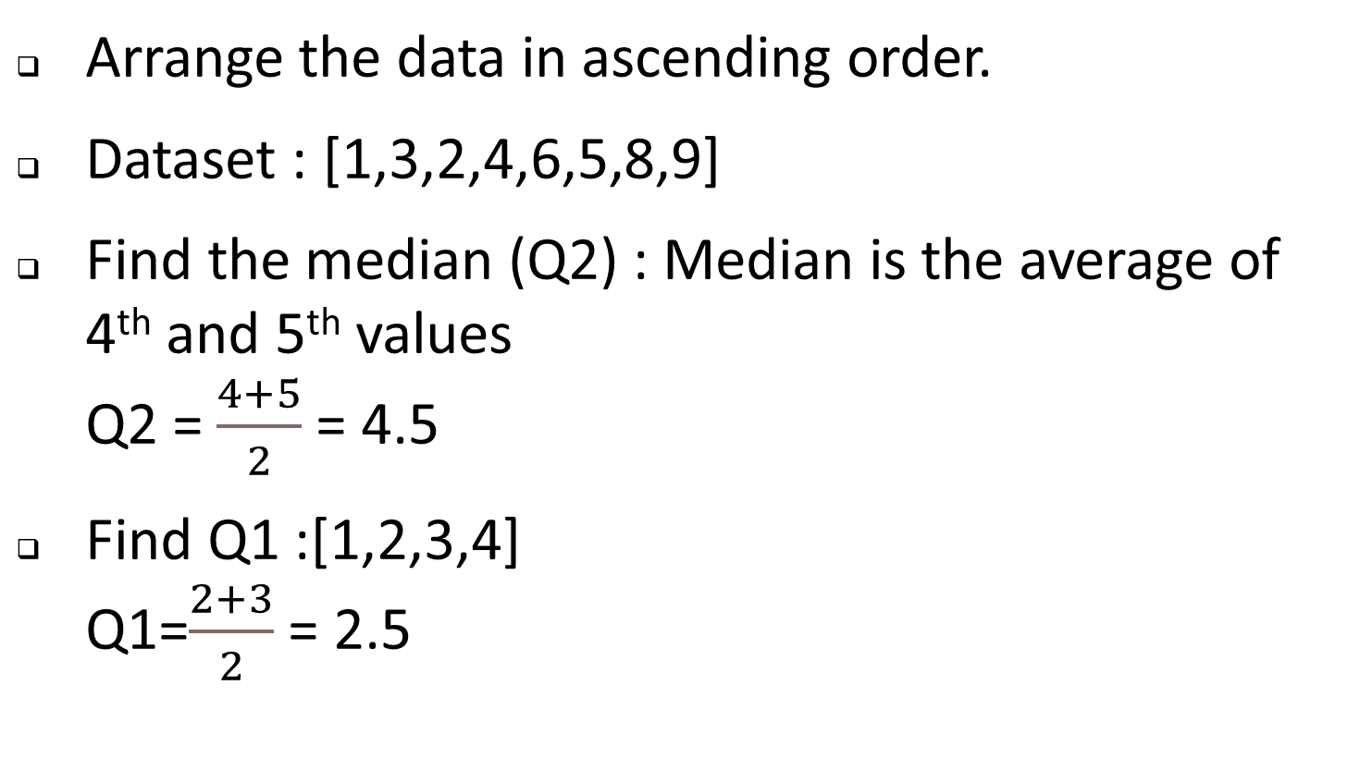
Calculate the IQR for an even no. of observations

Slide 19
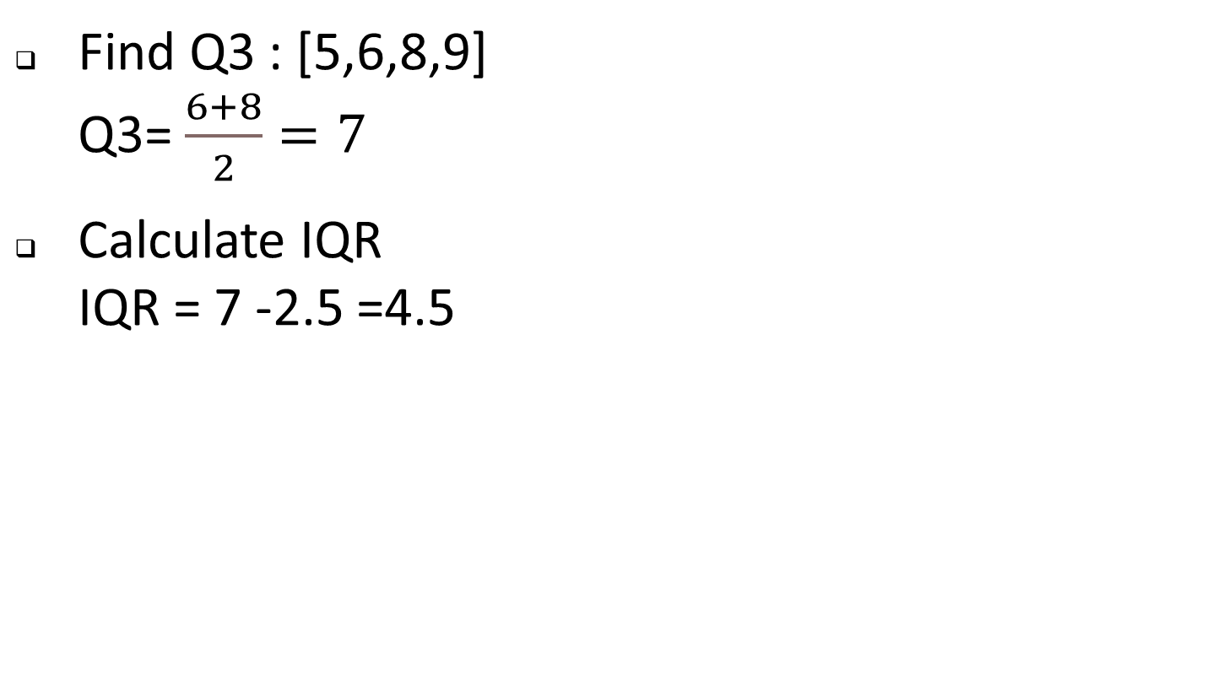

Slide 20
Quartiles , Percentage and Percentiles

Slide 21
QUARTILES
Values that divide a dataset into 3 equal parts.
Q1 : Lower Quartile (Represent 25th percentile) (Median of the lower half of the dataset)
Q2 : Median(50%) (Dividing it into two equal half)
Q3 : Upper Quartile ( 75th percentile) (Median of the upper half of the dataset)

Slide 22
Lower Fence and Upper Fence
These are boundaries used in statistics to identify outliers in a dataset . They are calculated using IQR and quartiles (Q1 and Q3)
Outliers : Datapoints that fall outside the boundaries defined by IQR .Specifically outside the upper and lower fence.

Slide 23
LOWER FENCE:
Lower boundary below which data points are considered as outliers.
Lower Fence = Q1-1.5*IQR
UPPER FENCE:
Upper boundary above which datapoints are considered as outliers.
Upper Fence = Q3+1.5*IQR

Slide 24
EXAMPLE
Dataset :[1,2,3,4,5,6,8,9]
1)Calculate Quartiles(Q1,Q3)
Arrange data in ascending order : [1,2,3,4,5,6,8,9]
Q1=(1,2,3,4)=2.5
Q3=(5,6,8,9)=7
2)Calculate IQR
IQR = 7-2.5=4.5

Slide 25
3) Calculate Lower fence and Upper fence
LF=Q1-1.5*IQR = 2.5-1.5*4.5 = 2.5-6.75 = -4.25
Any data point below -4.25 is considered as potential outlier

Slide 26
UF=Q3+1.5*IQR = 7+1.5*4.5 = 7+6.75 = 13.75
Any data point above 13.75 is considered as a potential outlier.
Data points outside the boundaries(below - 4.25/above 13.75) are potential outliers.

Slide 27

PERCENTAGE
Used to express a part of a whole as a fraction of 100. Used to compare relative sizes , proportions and changes commonly used in statistics, finance and everyday calculations.
Percentage =

Slide 28
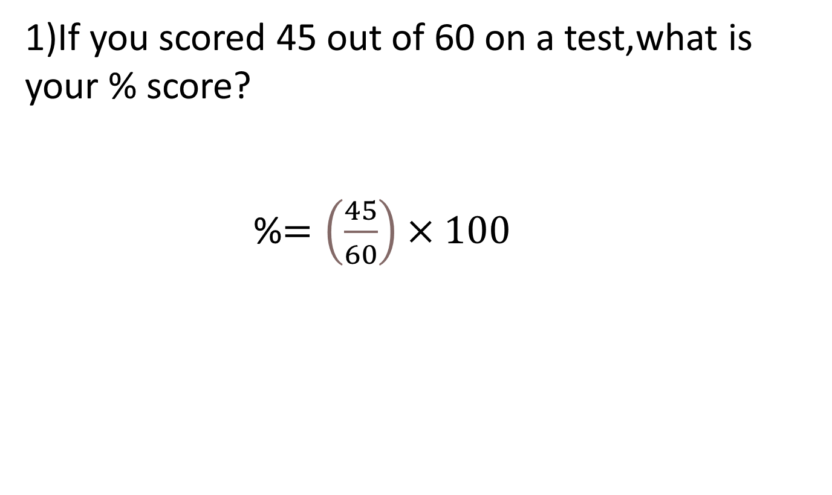
EXAMPLE

Slide 29
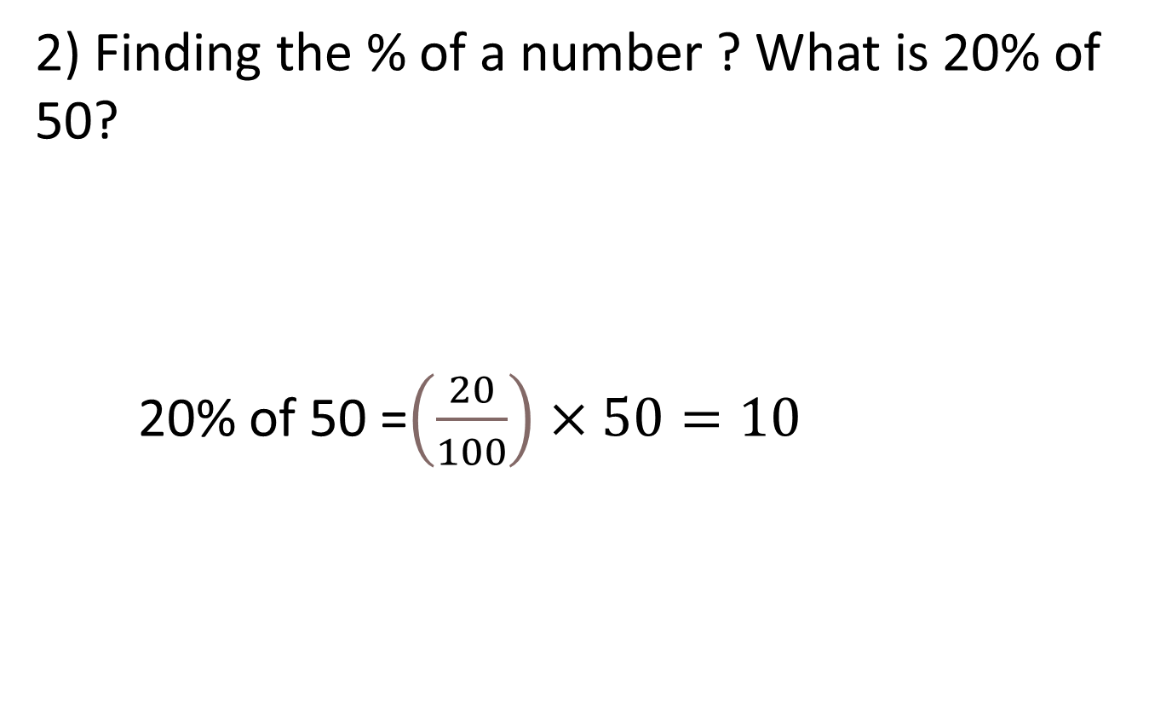

Slide 30
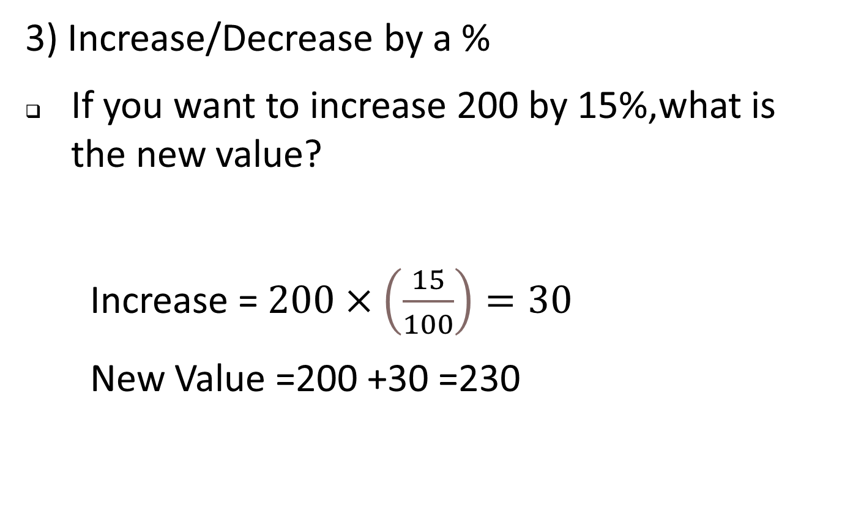

Slide 31
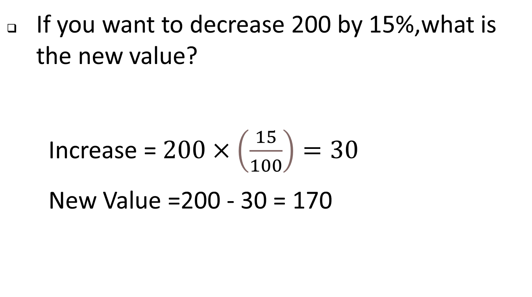

Slide 32
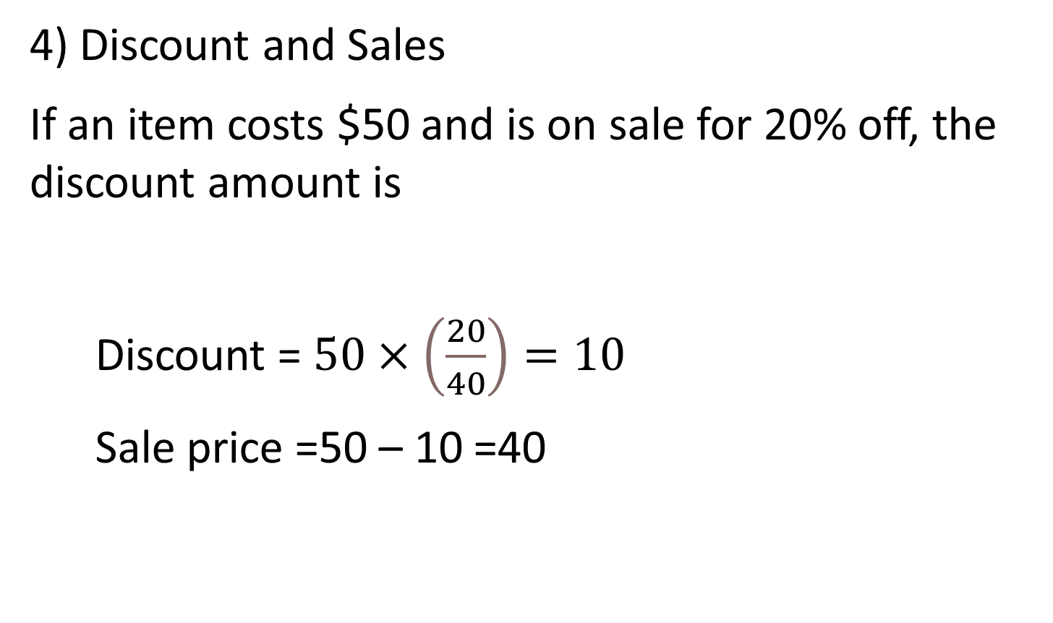

Slide 33
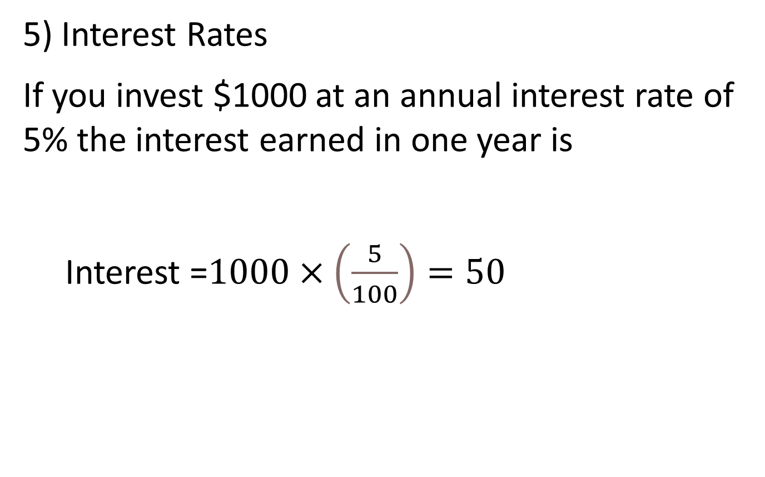

Slide 34
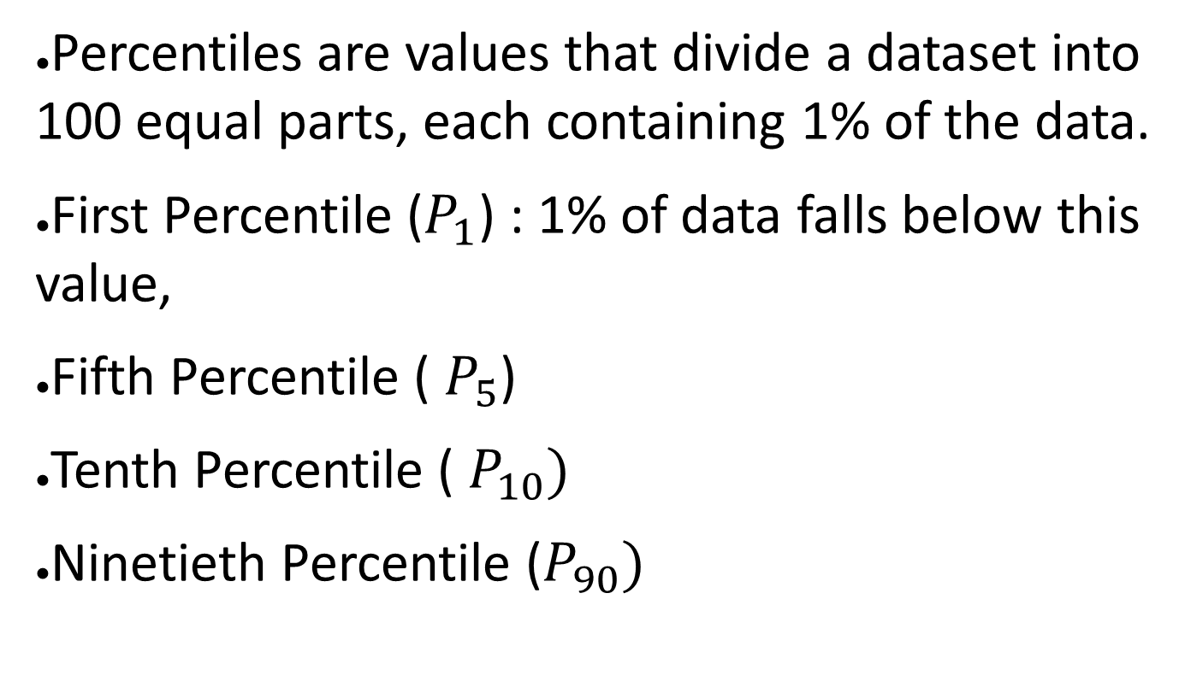
PERCENTILES

Slide 35
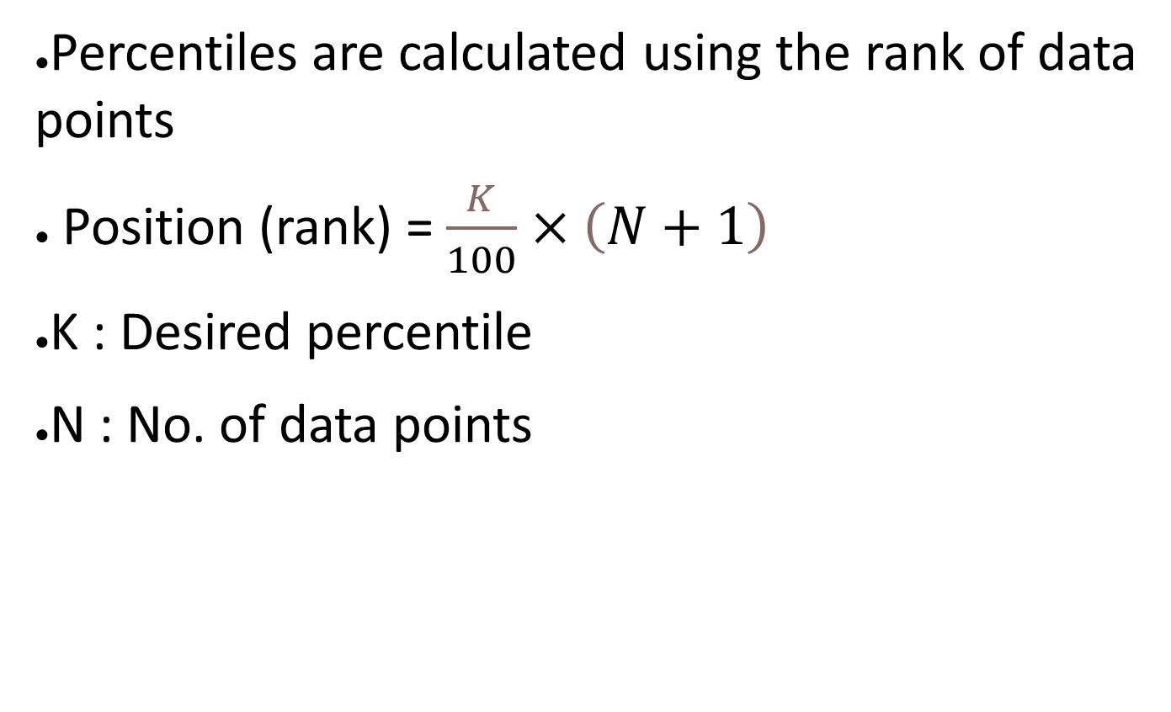

Slide 36
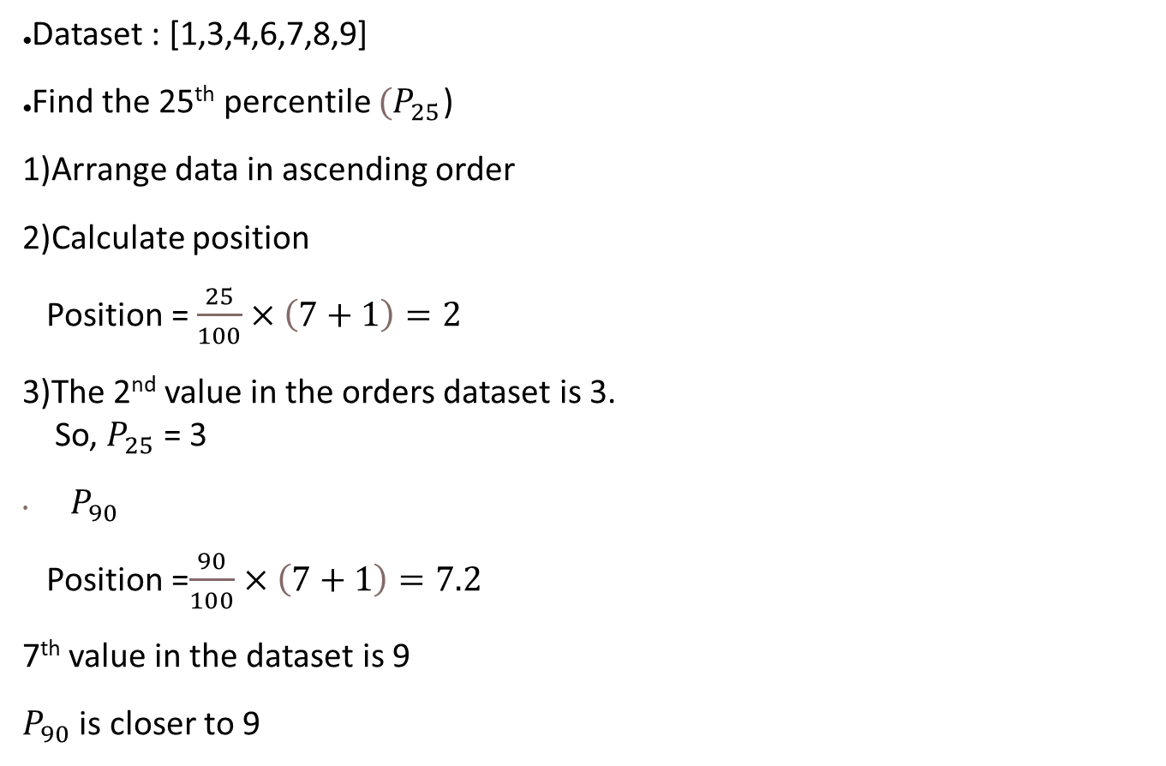
EXAMPLE

Slide 37
INFERENTIAL STATISTICS
Inferential statistics is used to make predictions about a population based on a sample of data.
There are 2 types of inferential statistics:
Hypothesis Testing
Regression Analysis
Confidence Intervals

